Slide 2

Balanced
Accumulation
Finding the right mix of growth
potential and asset protection
38191Z
PRT 9-24

Slide 3

What does risk look like to you?
The goal in accumulating retirement savings is to balance risk safely between asset growth potential and asset protection. You want to ensure what you are saving can grow and provide some level of asset protection in case of economic volatility.
Stocks, Mutual funds,
Variable annuities, Bonds
Cash, CDs, Bank Money market,
Fixed index annuities, Fixed annuities
EXPOSED
NOT EXPOSED
to market risk
to market risk
PRT 9-24
38191Z
PRT 9-24

Slide 4
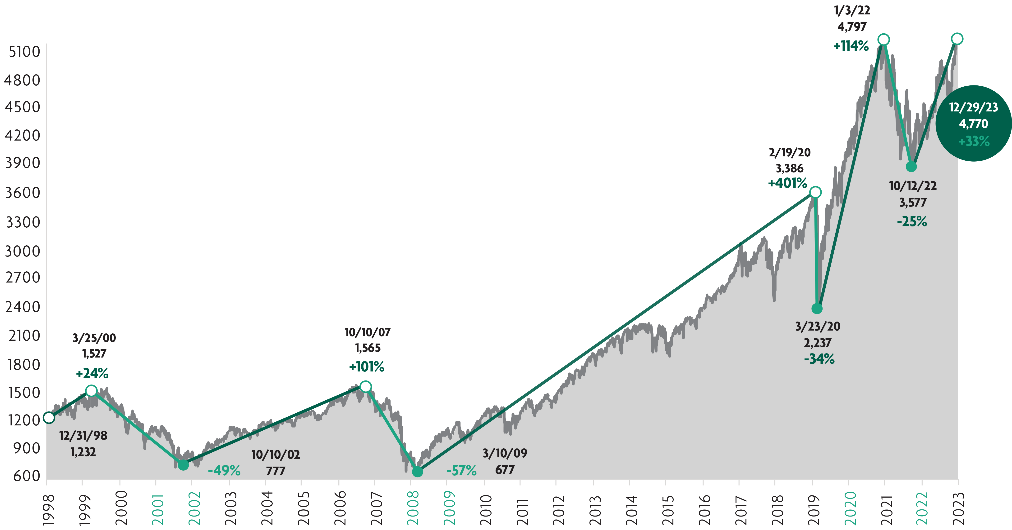
S&P 500® performance history
Retire on your terms –
not when the market dictates
Financial data sourced from Bloomberg 12/31/2023. These numbers depict historical returns and do not guarantee future performance.

Slide 5
Volatility
Are you overexposed?
Market volatility continues to rise on both the gains and losses front. If you have all your retirement assets exposed to market volatility, you have seen both historic gains but also historic downturns. While the overall long-term value of the market is a net positive, you may have concerns about volatility impacting your assets as you approach retirement. Consider for example, what kind of gain is needed to recover from a market loss.
-10%
11.2%
-15%
17.7%
Return to “break even” after 1 year
Percent of loss
-20%
25%
-25%
33.4%
-30%
42.9%
-35%
53.9%
-40%
66.7%
-45%
81.9%
-50%
100%
-50%
-40%
-30%
-20%
-10%
0%
20%
40%
60%
80%
100%

Slide 6

Will your gains be overwhelmed by inflation or taxes?
Year | Annualized average six-month CD rate¹ | Taxes² | Inflation consumer price index (CPI)³ | Real return after taxes and inflation
2000 | 6.58% | 28% | 3.4% | 1.34%
2001 | 3.64% | 27.5% | 1.6% | 1.04%
2002 | 1.81% | 27% | 2.4% | -1.08%
2003 | 1.17% | 25% | 1.9% | -1.02%
2004 | 1.74% | 25% | 3.3% | -2.00%
2005 | 3.72% | 25% | 3.4% | -0.61%
2006 | 5.23% | 25% | 2.5% | 1.42%
2007 | 5.23% | 25% | 4.1% | -0.18%
2008 | 3.14% | 25% | 0.1% | 2.25%
2009 | 0.87% | 25% | 2.7% | -2.05%-
2010 | 0.53% | 25% | 1.5% | -1.10%
2011 | 0.33% | 25% | 3.0% | -2.75%
Year | Annualized average six-month CD rate¹ | Taxes² | Inflation consumer price index (CPI)³ | Real return after taxes and inflation
2012 | 0.23% | 25% | 1.7% | -1.53%
2013 | 0.20% | 25% | 1.5% | -1.35%
2014 | 0.13% | 25% | 0.8% | -0.70%
2015 | 0.13% | 25% | 0.7% | -0.60%
2016 | 0.14% | 25% | 2.1% | -2.00%
2017 | 0.16% | 25% | 2.1% | -1.98%
2018 | 0.27% | 22% | 1.9% | -1.69%
2019 | 0.43% | 22% | 2.3% | -1.96%
2020 | 0.20% | 22% | 1.4% | -1.24%
2021 | 0.90% | 22% | 7.0% | -6.93%
2022 | 0.26% | 22% | 6.5% | -6.30%
2023 | 1.21% | 22% | 3.4% | -2.46%
The hypothetical chart shows what a “real rate” of return can be when adjusted for any applicable taxes and potential inflation rates. The CD return rates above are calculated using the six-month annualized average monthly CD rate as reported by the Federal Reserve. The tax rate used in the example is the highest marginal federal income-tax rate based on $100,000 of taxable income for a married couple filing jointly. The tax rate assumed will not apply to every consumer, and a lower tax rate may have a more favorable impact on the real return. The use of alternate assumptions will produce different results.
1. Annualized average six-month CD rate: https://www.fdic.gov/regulations/resources/rates/ previous.html. 2. Highest marginal federal income-tax rates based on $100,000 income for a married couple filing jointly: https://taxfoundation.org/2023-tax-brackets/. 3. Inflation rates are based on the consumer price index (CPI), a measure of change in consumer prices as measured by the U.S. Department of Labor’s Bureau of Labor Statistics. The annual inflation rate shown the table above corresponds to the December 12-Month % Change in the CPI-U for each respective year: https://beta.bls.gov/dataViewer/view/timeseries/CUUR0000SA0.

Slide 7

How can you balance financial protection with potential growth?
Stocks
Mutual funds
Variable annuities
Principal/premium not protected; can lose value
Bonds
Principal/premium protected
Fixed index annuities
Fixed annuities
FIAs ensure your
premium is protected
from market
downturns, which
puts them below the
line on the chart.
CDs
Bank money market accounts
Cash
The above chart is meant to serve as a general guide of where FIAs may fall in the financial services spectrum of common products. It is not a guarantee of performance individually or performance correlation or safety of the above listed vehicles. Although fixed index annuities guarantee no loss of premium due to market downturns, deductions from the accumulation value for optional benefit riders or strategy fees or charges associated with allocations to enhanced crediting methods could exceed interest credited to the accumulation value, which would result in loss of premium.

Slide 8
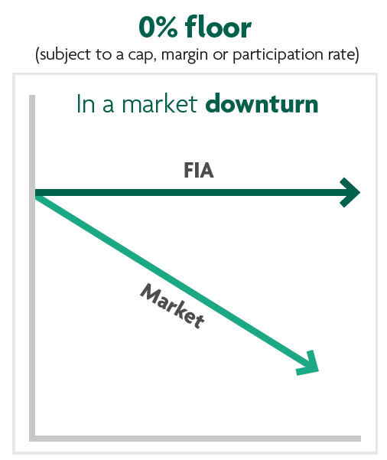
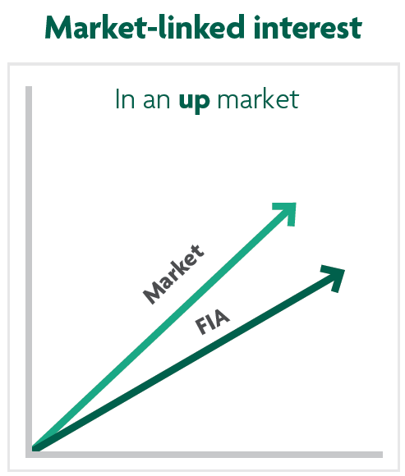
Fixed index annuities
How they perform in up and down markets
Fixed index annuities (FIAs) generally credit a portion of total index gains based on the crediting method chosen, but don’t lose value due to market downturns.

Slide 9
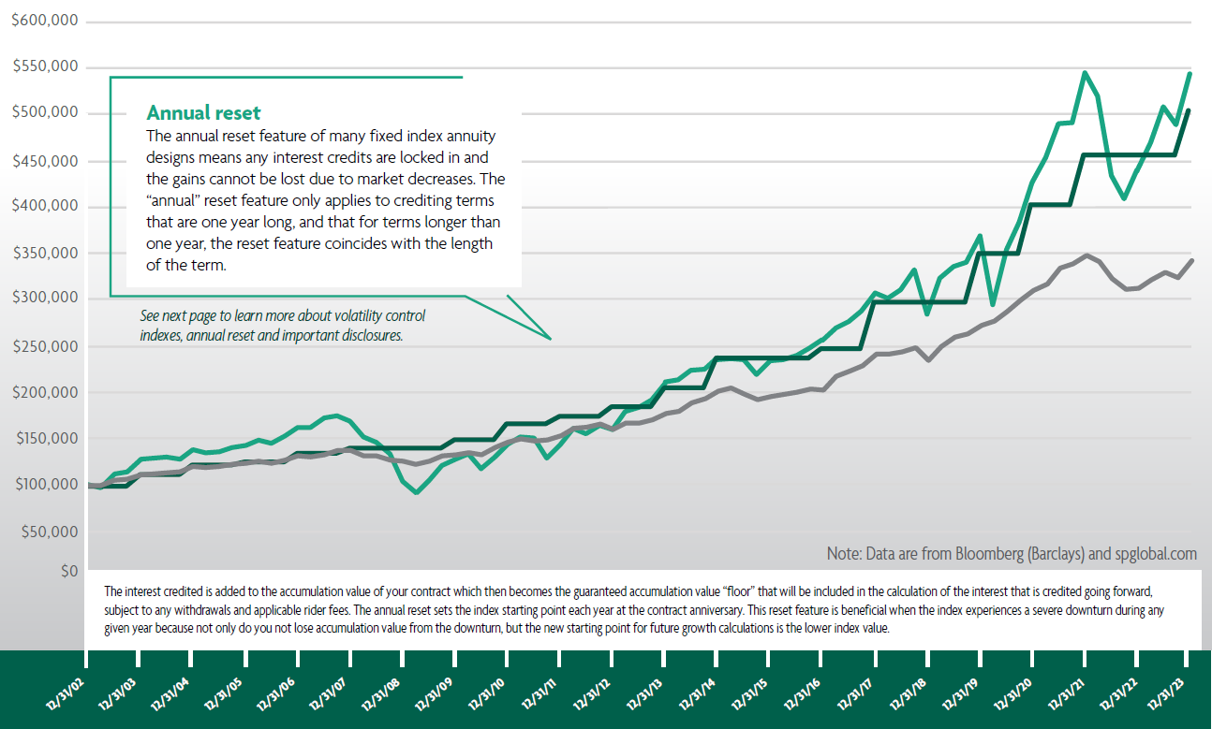
Volatility control + Annual reset
Fixed index annuity
(100% allocation to annual point to point with participation rate crediting method based on the S&P MARC 5% ER index) Accumulation value of a hypothetical fixed index annuity. Assumes no withdrawals. Interest credits to the accumulation value are subject to a hypothetical 75% participation rate. Does not reflect actual historical performance and is not a guarantee of future results.
Barclays Transitions 6% VC Index Based on a quarterly review of $100,000 directly invested in the Barclays Transitions 6% VC Index without dividends taken into account. Index has been in existence since March 31, 2023. Ending values in years prior to inception are determined by Barclays Bank PLC (“BBPLC”) or it’s affiliates using the same methodology as used currently.
S&P 500®
Based on a quarterly review of $100,000 directly invested in the S&P 500® without dividends taken into account.

Slide 10
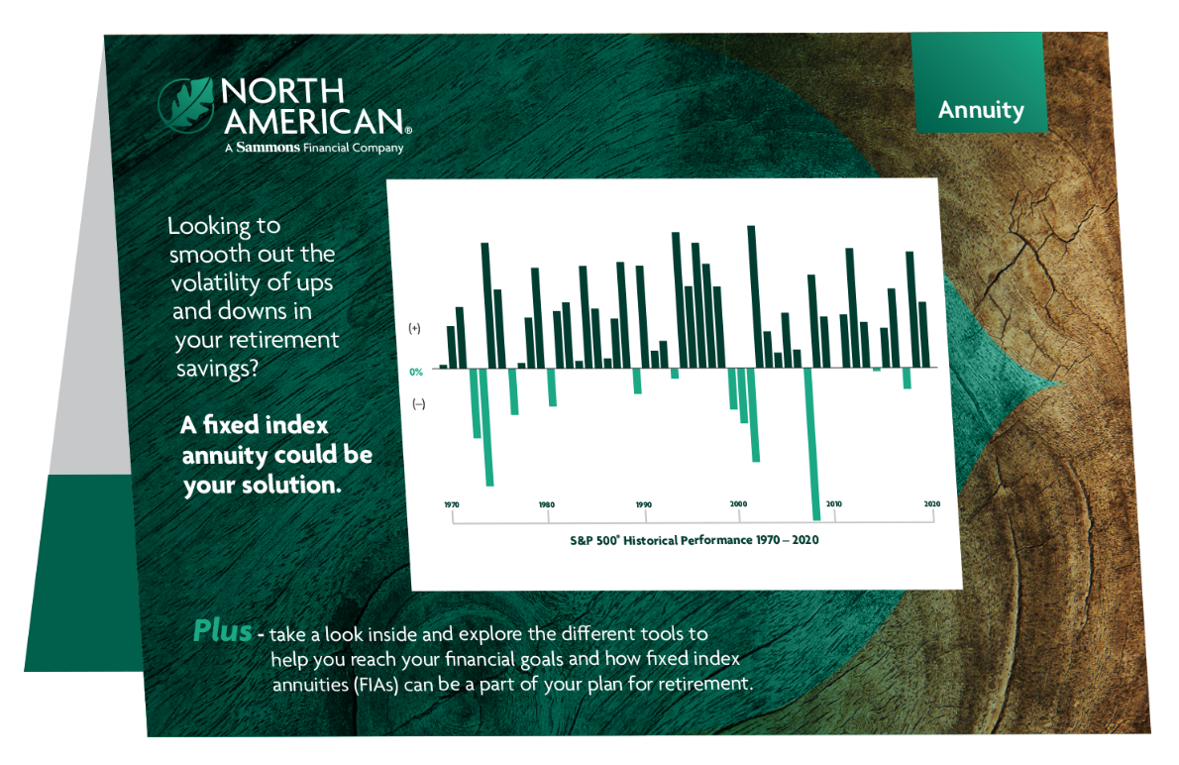
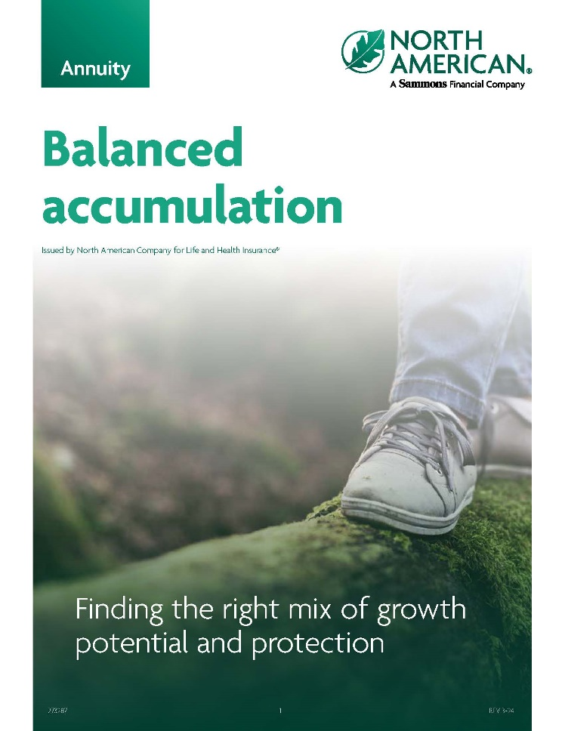
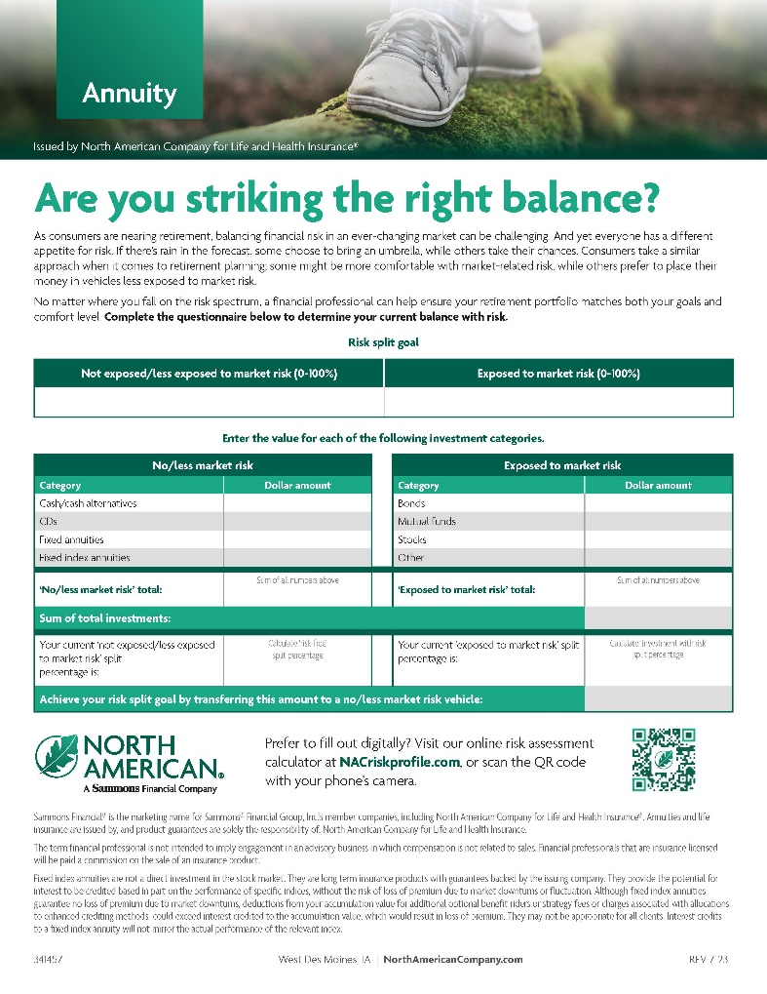
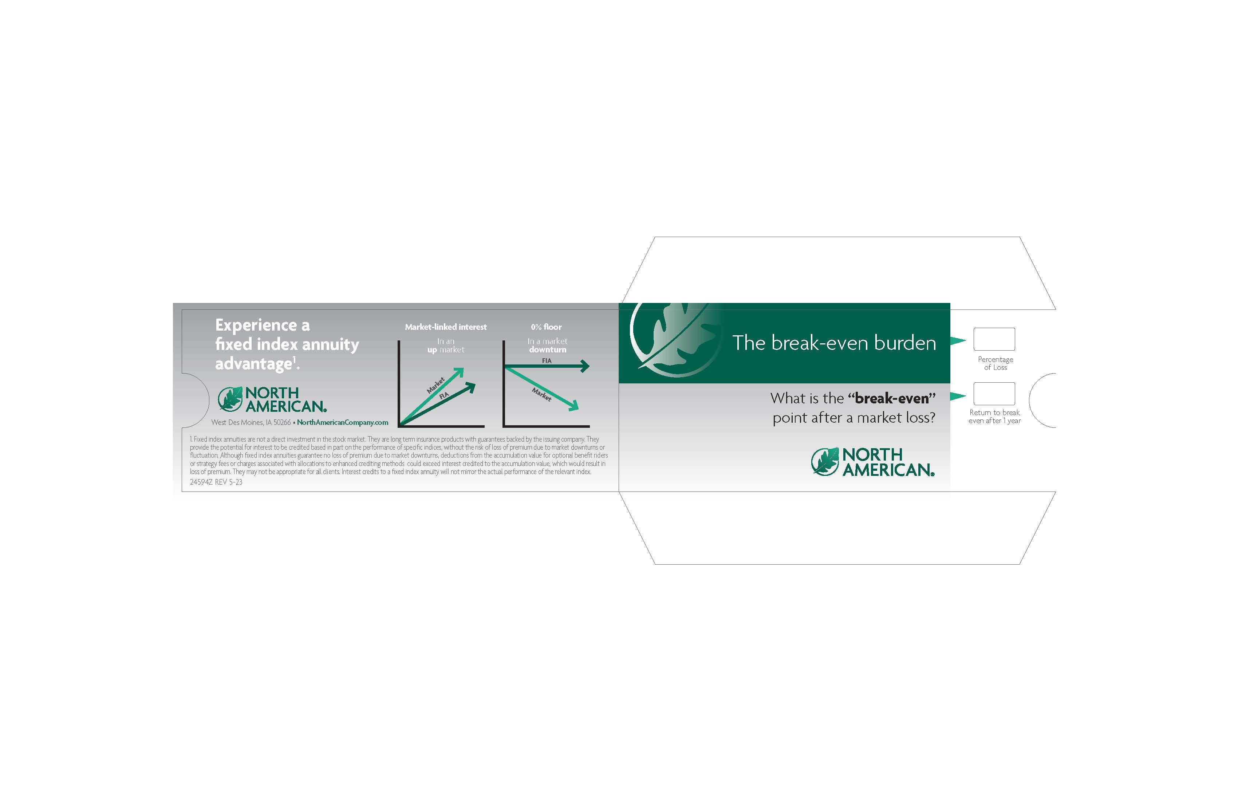
Balanced Accumulation

Slide 11





Over $117.8 billion¹
Total assets under Sammons
Financial Group Management
Over $110.9 billion¹
Sammons Financial Group
total liabilities
Over $39.6 billion²
North American life and
annuity total assets
Over $37.5 billion²
North American life and
annuity total liabilities
Over 1.7 million³
Life and annuity policy holders
Member companies
136+ years
North American Company for Life and Health Insurance®
The above ratings apply to North American’s financial strength and claims paying ability. These ratings do not apply to the safety or performance of the variable accounts, which will fluctuate in value. 1. As of December 31, 2023. Source: Statutory Annual Statements of the Sammons Financial Group member companies as filed with the National Association of Insurance Commissioners. 2. Source: North American Balance Sheet as of 12/31/2023. 3. Policy count, assets under management, per statutory basis, as of December 31, 2023.
38191Z
PRT 9-24

Slide 12
Currently “A+” rated by:
A.M. Best (Superior)^{A,B} – (Second category out of 15)
Superior ability to meet ongoing obligations to policyholders
S&P Global Ratings (Strong)^{B,C} – (Fifth category out of 22)
Very strong financial security characteristics
Fitch Ratings (Stable)^{D} - (Fifth category out of 19)
A strong business profile, low financial leverage, very strong capitalization, and strong operating profitability supported
by strong investment performance
A.M. Best is a large, third-party independent reporting and rating company that rates an insurance company on the basis of the company’s financial strength, operating performance, and ability to meet its obligations to policyholders. S&P Global Ratings is an independent, third-party rating firm that rates on the basis of financial strength. Ratings shown reflect the opinions of the rating agencies and are not implied warranties of the company’s ability to meet its financial obligations. The ratings above apply to North American’s financial strength and claims-paying ability. A) A.M. Best rating affirmed on August 13, 2024. For the latest rating, access ambest.com. B) Awarded to North American Company for Life and Health Insurance® as part of Sammons® Financial Group Inc., which consists of Midland National® Life Insurance Company and North American Company for Life and Health Insurance®. C) S&P Global rating assigned Feb. 26, 2009 and affirmed on May 22, 2024 . D) Fitch Ratings, a global leader in financial information services and credit ratings, on June 26, 2024, assigned an Insurer Financial Strength rating of A+ Stable for North American. This rating is the fifth highest of 19 possible rating categories. The rating reflects the organization’s strong business profile, low financial leverage, very strong statutory capitalization, and strong operating profitability supported by strong investment performance. For more information access fitchratings.com.
38191Z
PRT 9-24

Slide 13
Disclosures:
Sammons Financial® is the marketing name for Sammons® Financial Group, Inc.’s member companies, including North American Company for Life and Health Insurance®. Annuities and life insurance are issued by, and product guarantees are solely the responsibility of, North American Company for Life and Health Insurance.
Insurance products issued by North American Company for Life and Health Insurance®, West Des Moines, Iowa. Product and features/options may not be available in all states or appropriate for all clients. See product materials and state availability chart for further details, specific features/options, and limitations by product and state.
Fixed index annuities are not a direct investment in the stock market. They are long term insurance products with guarantees backed by the issuing company. They provide the potential for interest to be credited based in part on the performance of specific indices, without the risk of loss of premium due to market downturns or fluctuation. Although fixed index annuities guarantee no loss of premium due to market downturns, deductions from the accumulation value for optional benefit riders or strategy fees or charges associated with allocations to enhanced crediting methods could exceed interest credited to the accumulation value, which would result in loss of premium. They may not be appropriate for all clients. Interest credits to a fixed index annuity will not mirror the actual performance of the relevant index.
The “S&P 500®”, and “S&P Multi-Asset Risk Control 5% Excess Return Index”, (“the Indices”) are products of S&P Dow Jones Indices LLC or its affiliates (“SPDJI”) and have been licensed for use by North American Company for Life and Health Insurance® (“the Company”). S&P®, S&P 500®, US 500, The 500, iBoxx®, iTraxx® and CDX® are trademarks of S&P Global, Inc. or its affiliates (“S&P”); Dow Jones® is a registered trademark of Dow Jones Trademark Holdings LLC (“Dow Jones”). It is not possible to invest directly in an index. The Company’s Product is not sponsored, endorsed, sold or promoted by SPDJI, Dow Jones, S&P, any of their respective affiliates (collectively, “S&P Dow Jones Indices”). S&P Dow Jones Indices does not make any representation or warranty, express or implied, to the owners of the Company’s Product or any member of the public regarding the advisability of investing in securities generally or in the Company’s Product particularly or the ability of the Indices to track general market performance. Past performance of an index is not an indication or guarantee of future results. S&P Dow Jones Indices’ only relationship to the Company with respect to the Indices is the licensing of the Index and certain trademarks, service marks and/or trade names of S&P Dow Jones Indices and/or its licensors. The Indices are determined, composed and calculated by S&P Dow Jones Indices without regard to the Company or the Company’s Product. S&P Dow Jones Indices has no obligation to take the needs of the Company or the owners of the Company’s Product into consideration in determining, composing or calculating the Indices. S&P Dow Jones Indices has no obligation or liability in connection with the administration, marketing or trading of the Company’s Product. There is no assurance that investment products based on the Indices will accurately track index performance or provide positive investment returns. S&P Dow Jones Indices LLC is not an investment adviser, commodity trading advisory, commodity pool operator, broker dealer, fiduciary, “promoter” (as defined in the Investment Company Act of 1940, as amended), “expert” as enumerated within 15 U.S.C. § 77k(a) or tax advisor. Inclusion of a security, commodity, crypto currency or other asset within an index is not a recommendation by S&P Dow Jones Indices to buy, sell, or hold such security, commodity, crypto currency or other asset, nor is it considered to be investment advice or commodity trading advice.
S&P DOW JONES INDICES DOES NOT GUARANTEE THE ADEQUACY, ACCURACY, TIMELINESS AND/OR THE COMPLETENESS OF THE INDICES OR ANY DATA RELATED THERETO OR ANY COMMUNICATION, INCLUDING BUT NOT LIMITED TO, ORAL OR WRITTEN COMMUNICATION (INCLUDING ELECTRONIC COMMUNICATIONS) WITH RESPECT THERETO. S&P DOW JONES INDICES SHALL NOT BE SUBJECT TO ANY DAMAGES OR LIABILITY FOR ANY ERRORS, OMISSIONS, OR DELAYS THEREIN. S&P DOW JONES INDICES MAKES NO EXPRESS OR IMPLIED WARRANTIES, AND EXPRESSLY DISCLAIMS ALL WARRANTIES, OF MERCHANTABILITY OR FITNESS FOR A PARTICULAR PURPOSE OR USE OR AS TO RESULTS TO BE OBTAINED BY THE COMPANY, OWNERS OF THE COMPANY’S PRODUCT, OR ANY OTHER PERSON OR ENTITY FROM THE USE OF THE INDICES OR WITH RESPECT TO ANY DATA RELATED THERETO. WITHOUT LIMITING ANY OF THE FOREGOING, IN NO EVENT WHATSOEVER SHALL S&P DOW JONES INDICES BE LIABLE FOR ANY INDIRECT, SPECIAL, INCIDENTAL, PUNITIVE, OR CONSEQUENTIAL DAMAGES INCLUDING BUT NOT LIMITED TO, LOSS OF PROFITS, TRADING LOSSES, LOST TIME OR GOODWILL, EVEN IF THEY HAVE BEEN ADVISED OF THE POSSIBILITY OF SUCH DAMAGES, WHETHER IN CONTRACT, TORT, STRICT LIABILITY, OR OTHERWISE. S&P DOW JONES INDICES HAS NOT REVIEWED, PREPARED AND/OR CERTIFIED ANY PORTION OF, NOR DOES S&P DOW JONES INDICES HAVE ANY CONTROL OVER, THE COMPANY’S PRODUCT REGISTRATION STATEMENT, PROSPECTUS OR OTHER OFFERING MATERIALS. THERE ARE NO THIRD-PARTY BENEFICIARIES OF ANY AGREEMENTS OR ARRANGEMENTS BETWEEN S&P DOW JONES INDICES AND THE COMPANY, OTHER THAN THE LICENSORS OF S&P DOW JONES INDICES.

Slide 14
The S&P 500® MARC 5% ER Index is managed to a volatility target, and as a result the index performance will not match the performance of any other index or the markets in general since volatility control tends to reduce both the rate of negative performance and positive performance of the underlying index, thereby creating more stabilized performance. This index has been in existence since Mar. 27, 2017. Ending values in years prior to inception are determined by S&P Dow Jones Indices LLC or its affiliates (“SPDJI”) using the same methodology as used currently.
Neither Barclays Bank PLC (“BB PLC”) nor any of its affiliates (collectively, “Barclays”) is the issuer or producer of fixed index annuities and Barclays has no responsibilities, obligations or duties to policyholders in fixed index annuities. The Barclays Transitions 12 VC IndexTM and the Barclays Transitions 6 VC IndexTM (the “Indexes”), together with any Barclays indices that are components of the Index is licensed for use by North American Company for Life and Health Insurance (“NACOLAH”) as the issuer or producer of fixed index annuities (the “Issuer”).
Barclays’ only relationship with the Issuer in respect of the Index is the licensing of the Index, which is administered, compiled and published by BB PLC in its role as the index sponsor (the “Index Sponsor”) without regard to the Issuer or the fixed index annuities or policyholders in the fixed index annuities. Additionally, the Issuer may for itself execute transaction(s) with Barclays in or relating to the Index in connection with fixed index annuities. Policyholders acquire fixed index annuities from the Issuer and policyholders neither acquire any interest in the Index nor enter into any relationship of any kind whatsoever with Barclays upon making a purchase in fixed index annuities. Fixed index annuities are not sponsored, endorsed, sold or promoted by Barclays and Barclays makes no representation regarding the advisability of the fixed index annuities or use of the Index or any data included therein. Barclays shall not be liable in any way to the Issuer, policyholders or to other third parties in respect of the use or accuracy of the Index or any data included therein.
Note on Simulated Returns: The results obtained from “back-testing” should not be considered indicative of the actual results that might be obtained from an investment in the Index. The actual performance of the Index may vary significantly from the results obtained from back-testing. Unlike an actual performance record, simulated results are achieved by means of the retroactive application of a back-tested model itself designed with the benefit of hindsight and knowledge of factors that may have possibly affected its performance. North American provides no assurance or guarantee that any product linked to the Index will operate or would have operated in the past in a manner consistent with these materials. Calculation based on simulated performance is purely hypothetical and may not be an accurate or meaningful comparison. Past performance (actual or simulated) is not necessarily indicative of future results.

